Slide 1


UNIVERSITY INSTITUTEOF ENGINEERING
Bachelor of Engineering (Computer Science & Engineering)
Operating System (CST-328)
Subject Coordinator: Er. Puneet kaur(E6913)
DISCOVER . LEARN . EMPOWER

Slide 2
Lecture 3 Types of Operating System
Simple Batch Systems
Multiprogrammed Batch Systems
Time-sharing operating systems
Distributed operating System
Network operating System
Real Time operating System
Hard real-time systems
Soft real-time systems

Slide 3
Batch operating system
In early days, computer work was given on punch cards and then these punch cards behave as input to the computer.
These jobs or batch jobs were then executed by the computer one by one. So that computers were called as batch computers or batch systems.
The work done by batch systems are in parts i.e. one job is processed then another job in the queue is processed and so on.
The various jobs of the users are collected in a queue. This process is known as Spooling (Simultaneous Peripheral Operations On Line).

Slide 4
Memory Layout for a Simple Batch System
OS
User
Program
Area

Slide 5
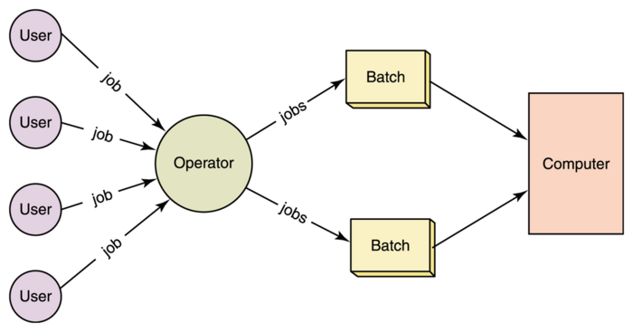
Batch Processing system

Slide 6
Batch operating system
Advantages -
Repeated jobs are done fast in batch systems without user interaction.
You don’t need special hardware and system support to input data in batch systems.
Best for large organizations but small organizations can also benefit from it.
Disadvantages -
Lack of interaction between the user and job.
CPU is often idle, because the speeds of the mechanical I/O devices is slower than CPU.
Difficult to provide the desired priority.
Examples – Payroll systems, Bank statements…etc.

Slide 7
Multiprogrammed Systems
This allows to execute multiple programs.
In this, several processes are kept in memory (set of jobs are kept in Job Pool) & CPU execute all these processes concurrently.
When one process start performing I/O operations , the CPU is allocated to another user process in the main memory that is ready to use the CPU.
Multiprogramming increases CPU utilization by organizing jobs so that the CPU always has one to execute.

Slide 8
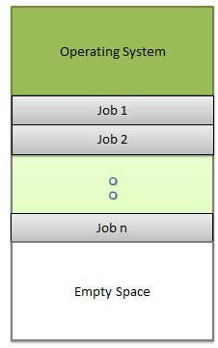
Memory layout for a multiprogramming system.

Slide 9
Multiprogrammed Systems
Advantages –
It increases CPU utilization.
It increases throughput also by utilizing idle time of CPU for running other programs that are already present in main memory.
It lowers the Response time by recognizing the priority of a job as it enters the system & by processing jobs on a priority basis.
Disadvantages -
It is fairly sophisticated and more complex.
A multiprogramming operating system must keep track of all kinds of jobs it is concurrently running.

Slide 10
Multitasking and Time-sharing operating systems
Time-sharing or Multitasking is a logical extension of
multiprogramming.
Processor's time which is shared among multiple users simultaneously is termed as time-sharing.
It refers to term where multiple jobs are executed by the CPU simultaneously by switching between them.
A time sharing operating system is that in which each task is given some time to execute and all tasks are given time so that all processes run seamlessly without any problem.
Suppose there are many users attached to a single system then each user has given time of CPU.
No user can feel to have trouble in using the system

Slide 11
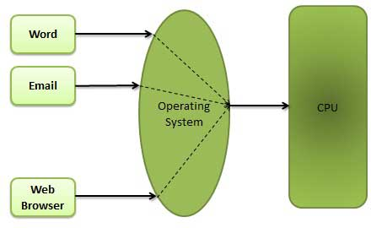
Multitasking and Time-sharing operating systems

Slide 12
Multitasking and Time-sharing operating systems
Advantages –
Provide advantage of quick response.
Reduces CPU idle time.
Disadvantages -
Problem of reliability.
Security and Integrity of user programs and data is at risk.
It consumes much resources so it need special operating systems.
Switching between tasks becomes overhead sometimes.

Slide 13
Multiprocessing systems
Multiprocessing is the use of two or more central processing units (CPUs) within a single computer system.
The term also refers to the ability of a system to support more than one processor and/or the ability to allocate tasks between them.
Advantage - 1.Increased throughput 2.Economy of scale 3. Increased reliability
Disadvantage - 1) If one processor fails then it will affect in the speed 2) Multiprocessor systems are expensive
3) Large main memory required.

Slide 14
Types of Multiprocessor systems
Symmetric Multiprocessor (SMP) –
In this, each CPU runs an identical copy of OS and can communicate as needed.
Asymmetric Multiprocessor (ASMP) –
In this, each processor assigned a specific task. This model is called master-slave since one CPU is the master and all the others are slaves.

Slide 15
Distributed systems
Distributed systems use multiple central processors to serve multiple real time application and multiple users.
Data processing jobs are distributed among the processors accordingly to which one can perform each job most efficiently.
The processors communicate with one another through various communication lines (such as high-speed buses or telephone lines). These are referred as loosely coupled systems or distributed systems.
Processors in a distributed system may vary in size and function. These processors are referred as sites, nodes, computers and so on.

Slide 16
Distributed systems
Advantages –
Speedup the exchange of data with one another via electronic mail.
Reduction of the load on the host computer.
Reliability (fault tolerance) - if some of the machines crash, the system can survive.
Sharing of data/resources - shared data is essential to many applications (banking, computer- supported cooperative work, reservation systems); other resources can be also shared (e.g. expensive printers).
Disadvantages –
Complex System - Distributed systems are much more complex to setup and difficult to maintain.
Security problems - sharing generates the problem of data security.
Networking problems: several problems are created by the network infrastructure, which have to be dealt with: loss of messages, overloading, ...

Slide 17
Real Time Systems
A real time operating system is the type of system which uses maximum time and resources to output exact and on the time result.
There is no difference between the results when same problem run on different occasion on same machine.
Real System is always on line whereas on line system need not be real time.
Real-time systems are used when there are rigid time requirements on the operation of a processor or the flow of data and real-time systems can be used as a control device in a dedicated application.
Real-time operating system has well-defined, fixed time constraints otherwise system will fail.
Example Scientific experiments, medical imaging systems, industrial control systems, weapon systems, robots, and home-applicance controllers, Air traffic control system etc.

Slide 18
Types of real-time operating systems
Hard real-time systems -
Hard real-time systems guarantee that critical tasks complete on time. For Ex. Scientific experiments, medical imaging systems, industrial control systems, weapon systems, robots, and home-applicance controllers, Air traffic control system etc.
Soft real-time systems -
Soft real time systems are less restrictive. Critical real-time task gets priority over other tasks and retains the priority until it completes. Soft real-time systems have limited utility than hard real-time systems.For example, Multimedia, virtual reality, Advanced Scientific Projects like undersea exploration and planetary rovers etc.

Slide 19
Real-time operating systems
Advantages -
Focus on Application - These type of operating system focus on applications which are running and usually give less importance to other application residing in waiting stage of life cycle. So less applications or tasks are managed and give exact result on current execution work.
Error Free - RTOS (Real Time Operating System) is error free that mean it has no chances of error in performing tasks.
24-7 systems: – RTOS can be best used for any applications which run 24 hours and 7 days because it do less task shifting and give maximum output.
Memory Allocation: - Memory allocation is best managed in these type of systems.
Disadvantages –
Expensive: - RTOS are usually very expensive because of the resources they need to work.
Not easy to program: - The designer have to write proficient program for real time operating system which is not easy as a piece of cake.
Low Priority Tasks: - The low priority tasks may not get time to run because these systems have to keep accuracy of current running programs

Slide 20
Real-time operating systems
Firm Real-time Operating System: RTOS of this type have to follow deadlines as well. In spite of its small impact, missing a deadline can have unintended consequences, including a reduction in the quality of the product. Example: Multimedia applications.
Advantages:
The advantages of real-time operating systems are as follows-
Maximum consumption – Maximum utilization of devices and systems. Thus more output from all the resources.
Task Shifting – Time assigned for shifting tasks in these systems is very less. For example, in older systems, it takes about 10 microseconds. Shifting one task to another and in the latest systems, it takes 3 microseconds.
Focus On Application – Focus on running applications and less importance to applications that are in the queue.
Real-Time Operating System In Embedded System – Since the size of programs is small, RTOS can also be embedded systems like in transport and others.
Error Free – These types of systems are error-free.
Memory Allocation – Memory allocation is best managed in these types of systems.

Slide 21
Conclusion
Learning this lecture will enable the students to understand various types of operating systems. It also gives students the opportunity to compare different types of operating systems on the basis of advantages and disadvantages mentioned in these slides.

Slide 22
References
https://www.includehelp.com/c-programming-questions/
https://www.studytonight.com/operating-system/
https://computing.llnl.gov/tutorials/
https://www.tutorialspoint.com/operating_system/index.htm#:~:text=An%20operating%20system%20(OS)%20is,software%20in%20a%20computer%20system.
https://www.javatpoint.com/os-tutorial
https://www.guru99.com/operating-system-tutorial.html
https://www.geeksforgeeks.org/operating-systems/

